Slide 1
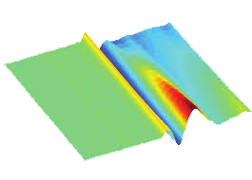
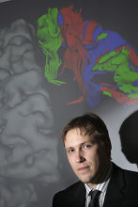
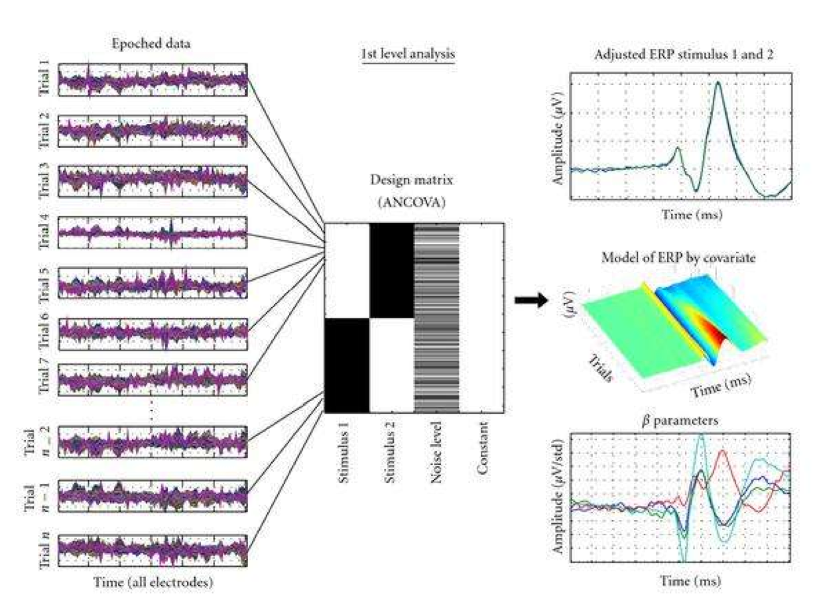
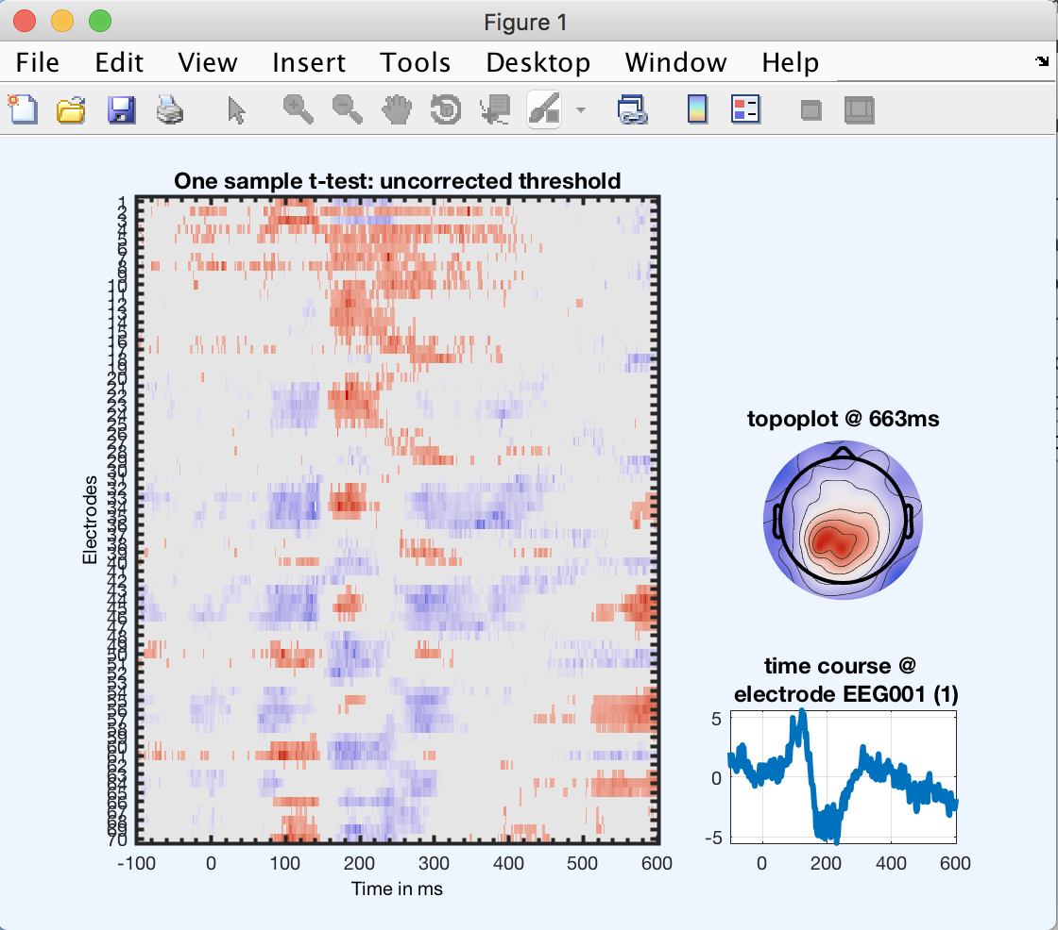
General Linear Modeling in EEGLAB/LIMO
Watch the videos
to be prepared
People cannot reproduce
the video (take screen caps)
Video select famous, scambled, unfamiliar
while in real life we select combined
values
Practice
Arnaud Delorme
Cyril Pernet

Slide 2

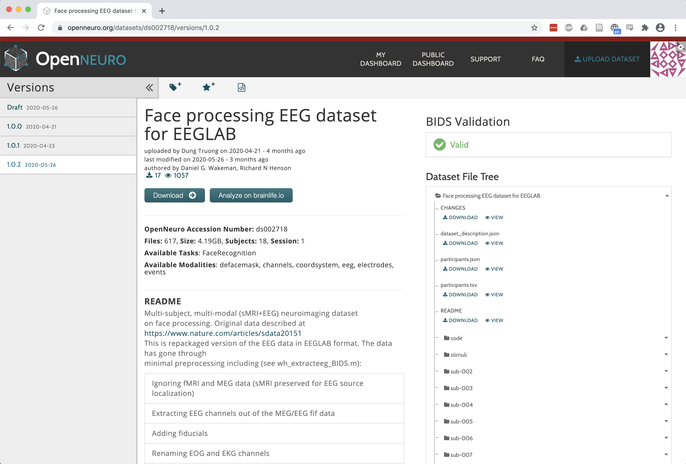
https://www.nature.com/articles/sdata20151
Download the data at
https://openneuro.org/datasets/ds002718

Slide 3
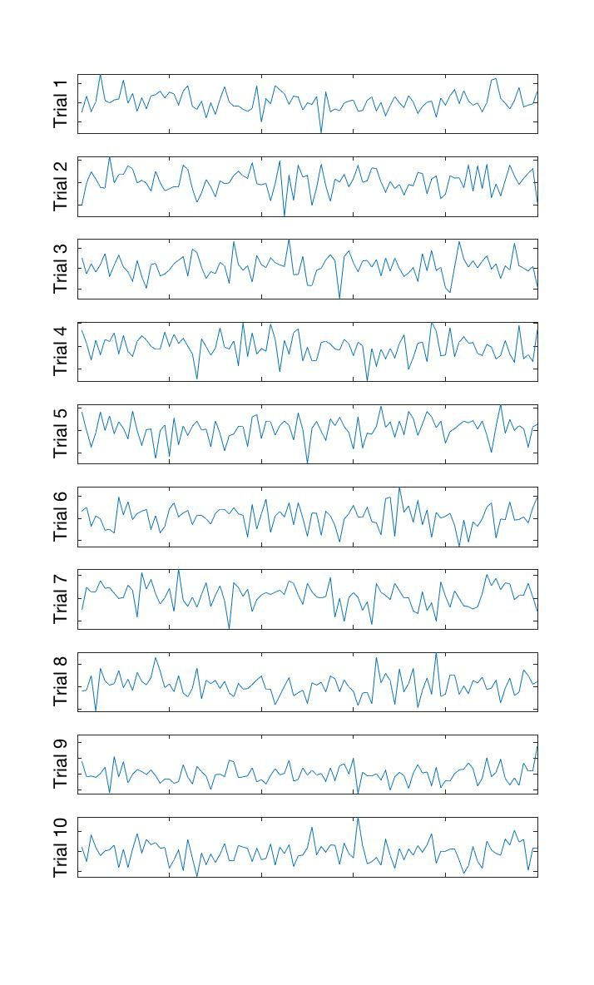
Linear Modeling of EEG data: level 1
Electrode 1
Continuous var.
Categorical var.
GLM: ordinary least square (OLS) versus weighted least square (WLS)
Significance: bootstrap trials to get confidence interval of beta parameters

Slide 4

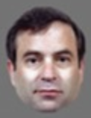
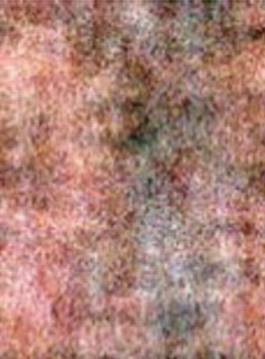
The Data
Famous
Unfamiliar
Scambled
3 types of stimuli: Famous faces, Non-famous faces, Scrambled faces
3 levels of repetition: 1st time, 2nd time (right after), 3rd time (delayed)
We need the conditions computed per subject (1st level) and then do the repeated measure ANOVA to test main effects and interactions.

Slide 5
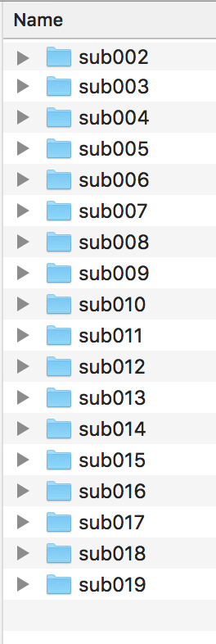
Let’s get started
Download the data
https://openneuro.org/datasets/ds002718
Open Matlab
Start EEGLAB

Slide 6
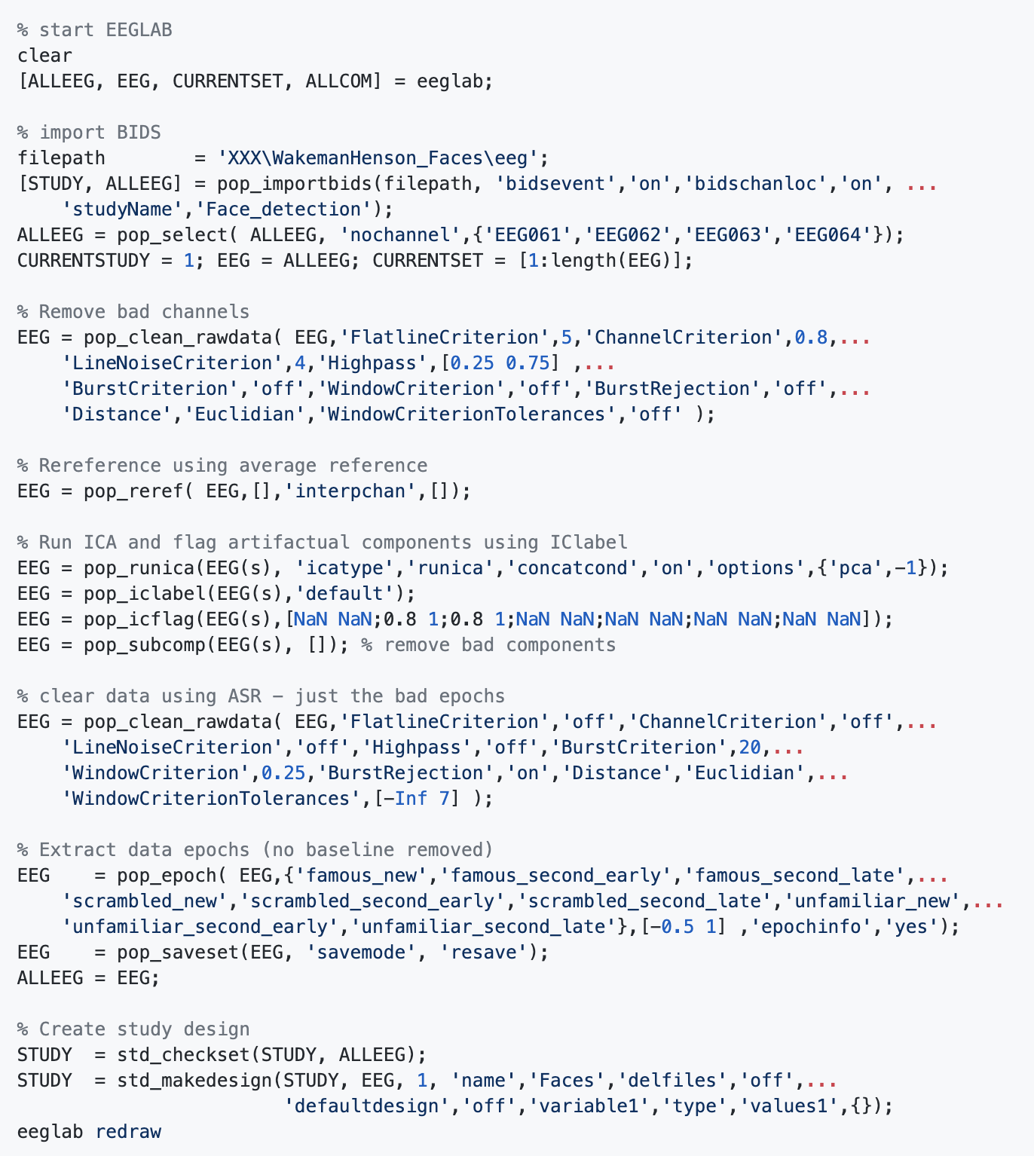
Import BIDS
dataset/remove
unwanted channels
Clean data
lightly
Re-reference
Run/Remove
ICA
Clean data
aggressively
Extract epochs
Create STUDY and STUDY design

Slide 7
Watch movie
Session_5.2_movie_1.mp4

Slide 8
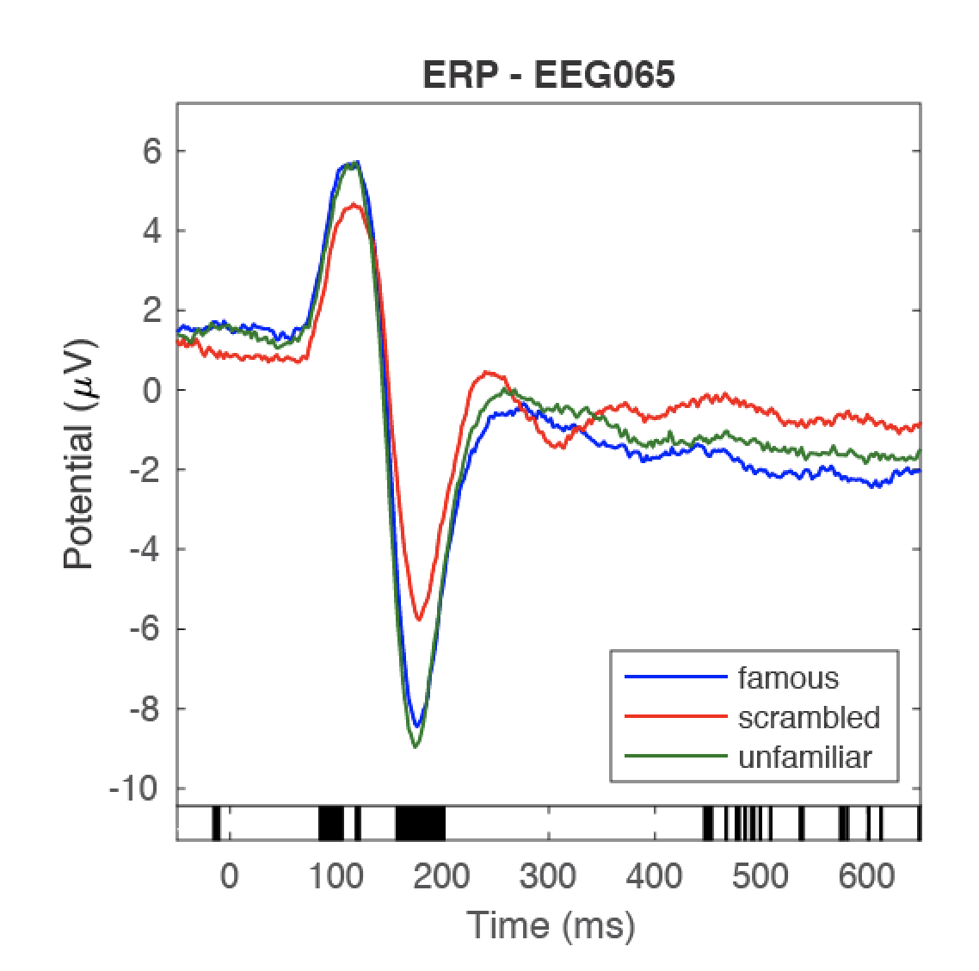
What are we going to do?
1 – Replicate Henson et al. – faces vs. scrambled
EEGLAB
Topography 170 ms
p<0.001

Slide 9
Watch movie
Session_5.2_movie_2.mp4

Slide 10
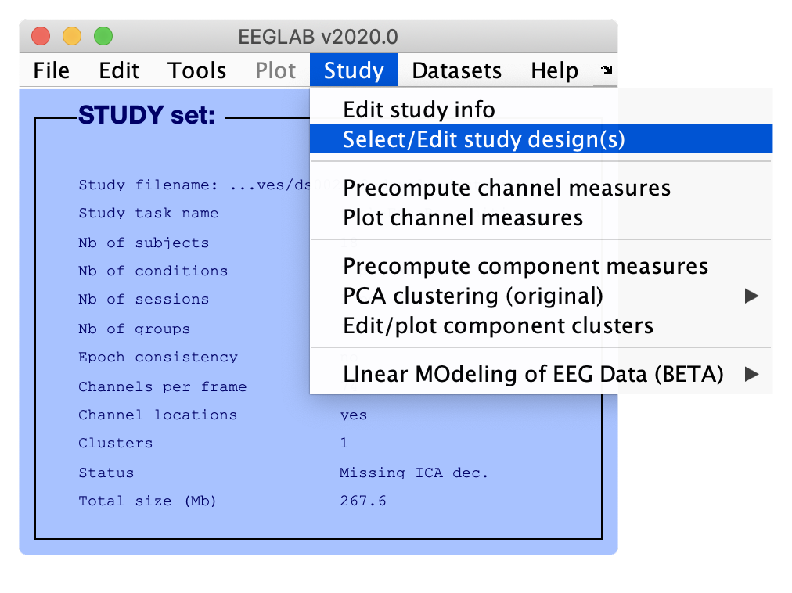
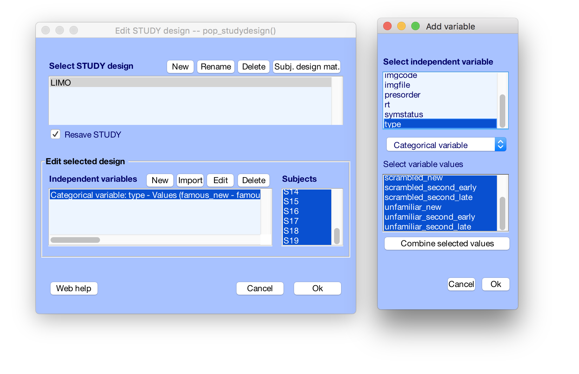
Create study designs
Here, we pick the ‘type’
and select all 9 conditions
The new STUDY interface allows all sorts of designs. By default, you model each and any condition / covariate (the more complete the model the better)

Slide 11
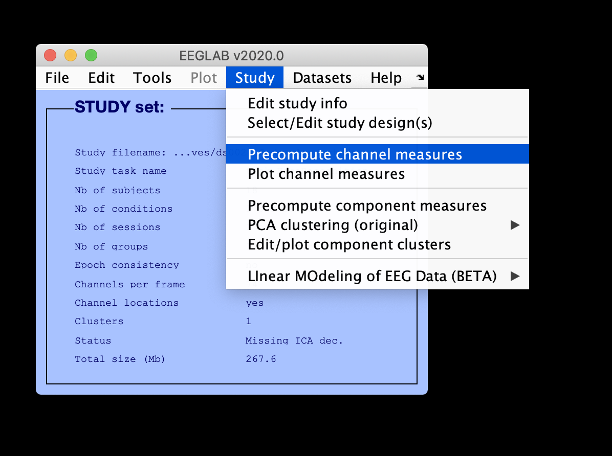
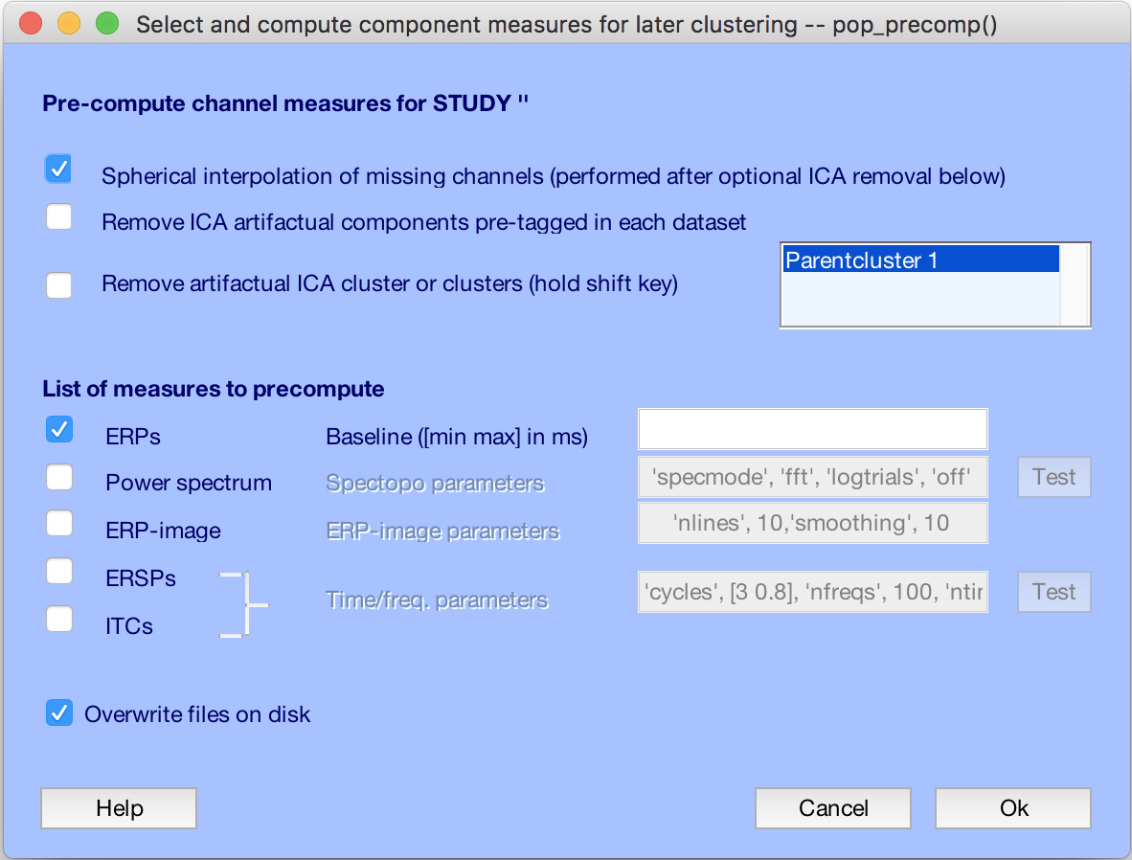
Precompute ERP
Precompute channel measures (single trials)
with or without interpolation of missing channels

Slide 12
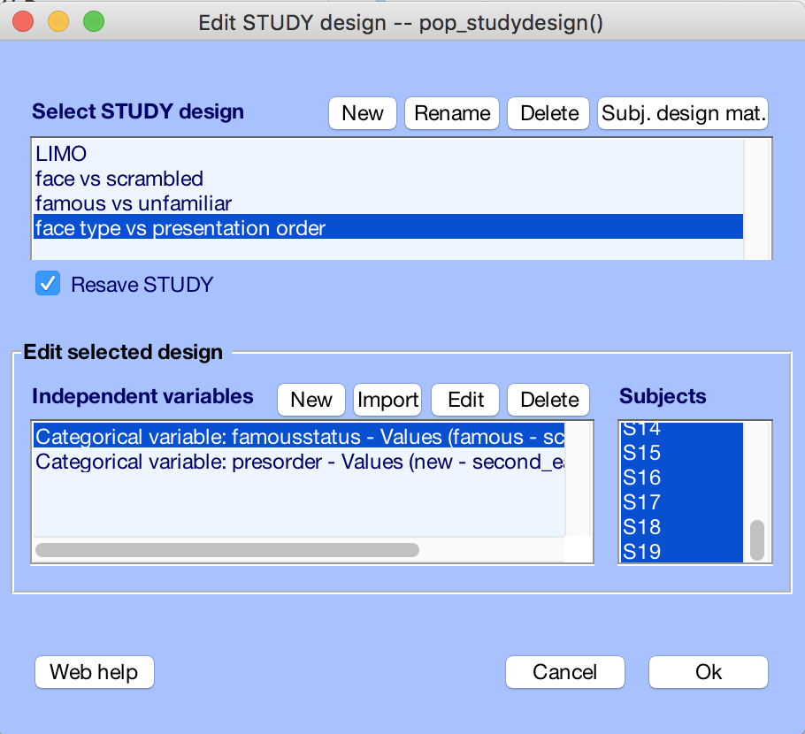
Create other study designs
Select/edit study design
The new STUDY interface allows all sorts of designs. By default, you model each and any condition / covariate (the more complete the model the better)

Slide 13
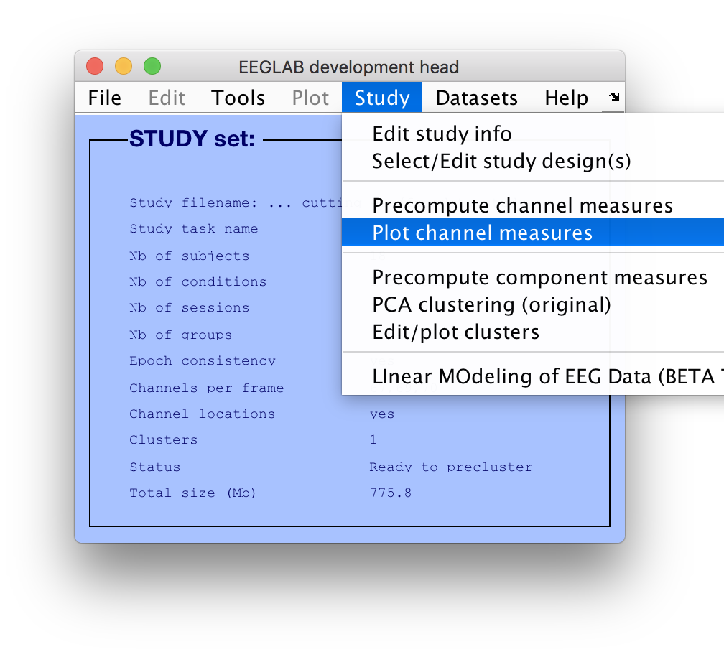
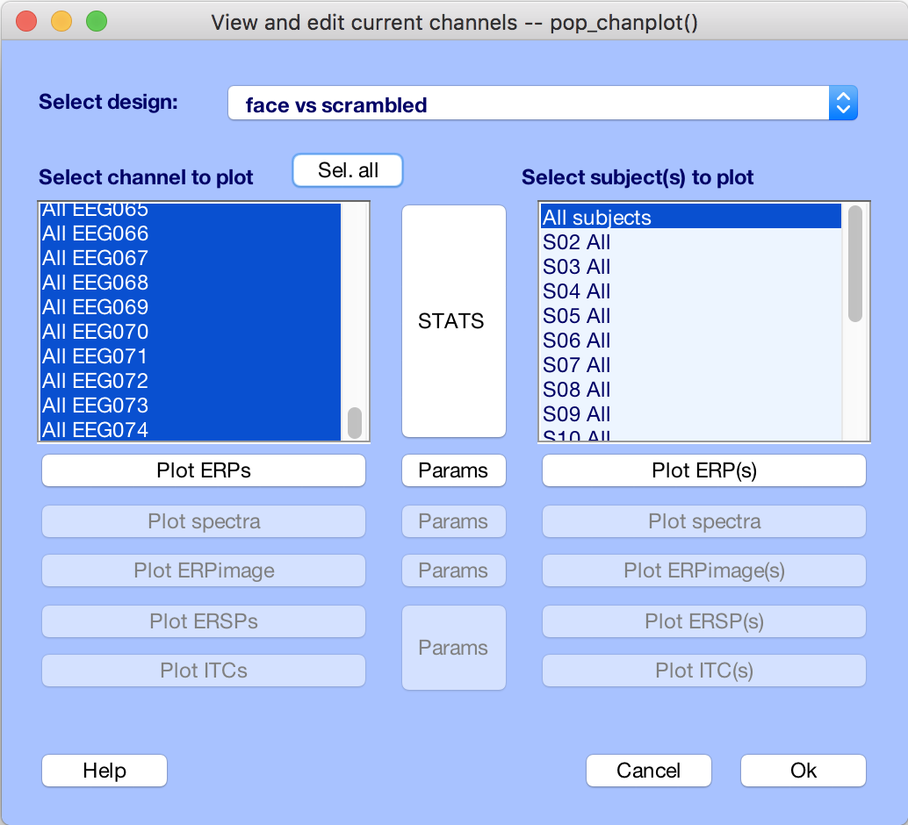
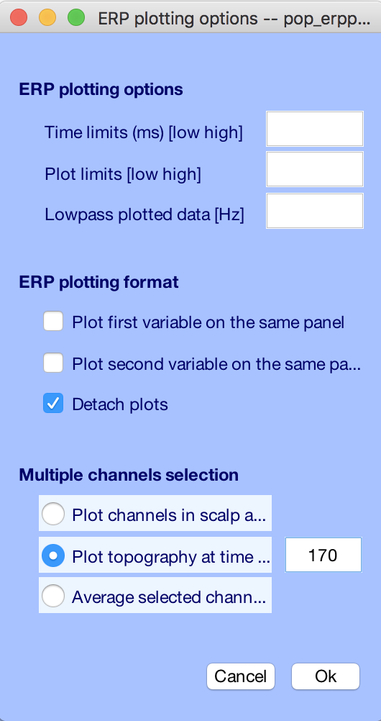
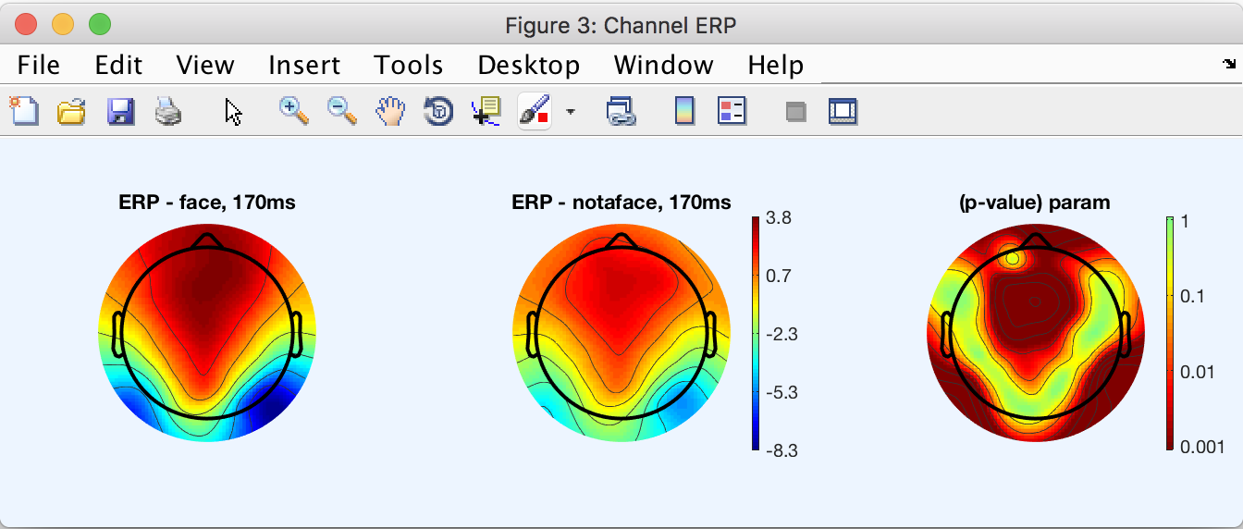
Standard EEGLAB statistics

Slide 14
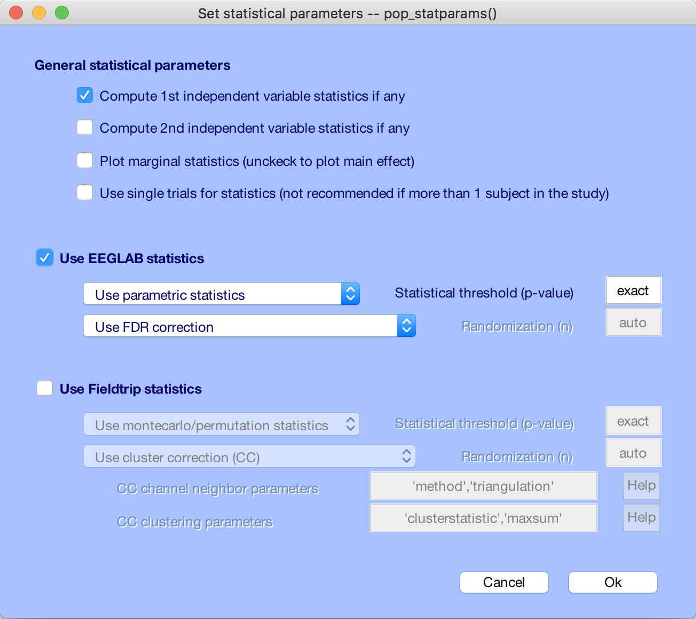
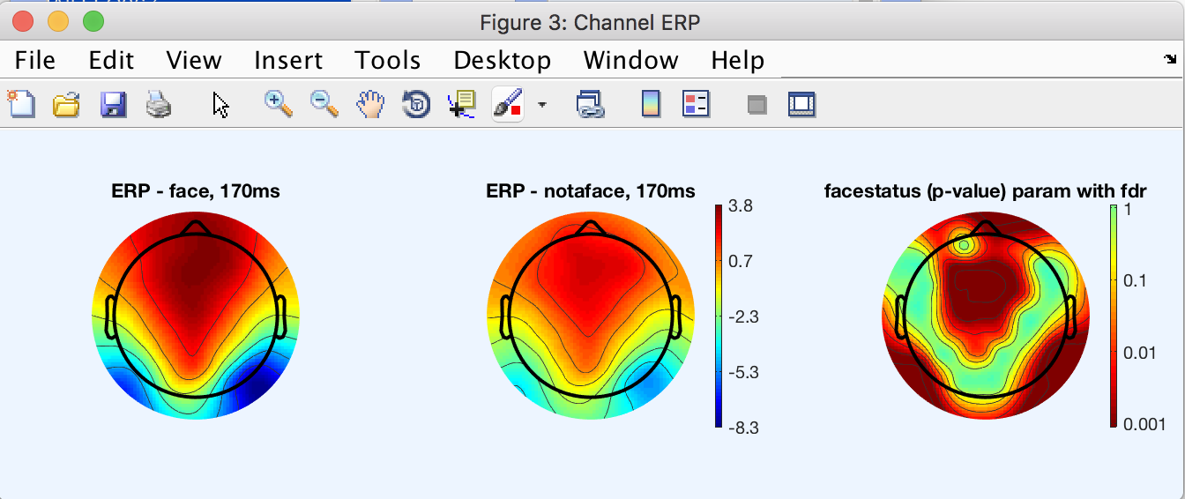
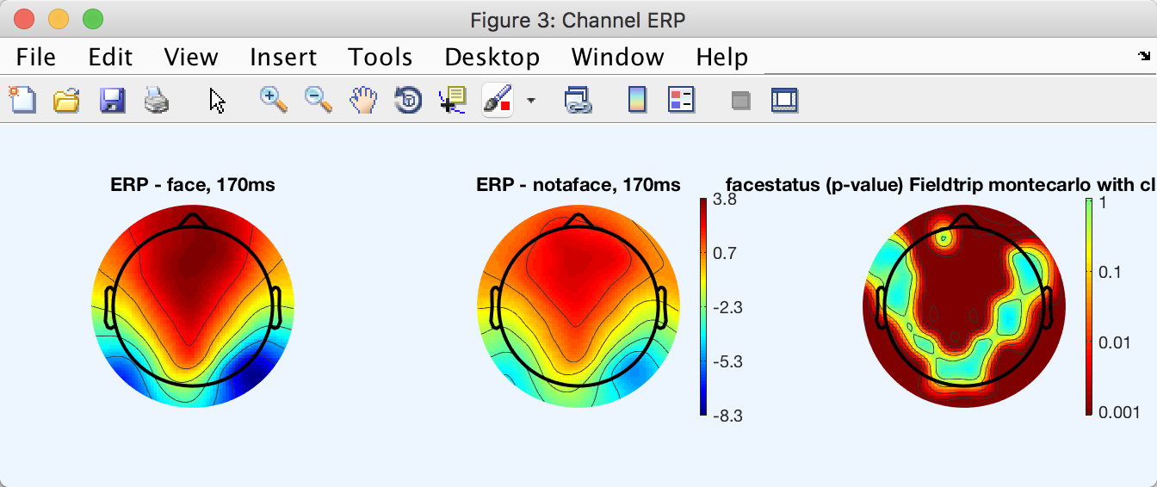
Uncorrected
Standard EEGLAB statistics
FDR corrected
Cluster corrected

Slide 15
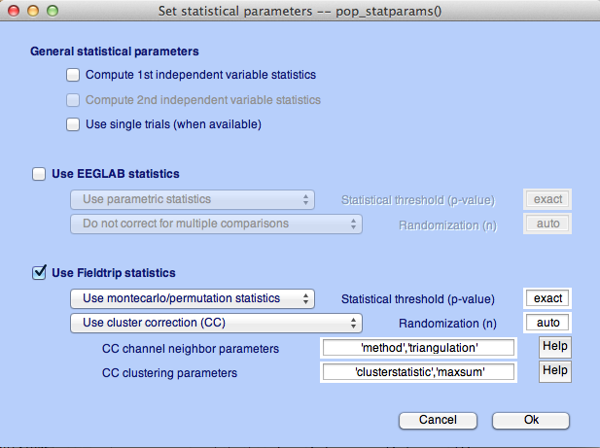
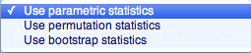
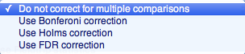
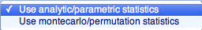
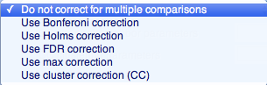
std_stat() function in EEGLAB

Slide 16
Exercise
Load “ds002718processed/Face_detection.study” file
Edit STUDY design and delete current variable(s) (menu item STUDY > Select/Edit STUDY design(s)) – Do not resave STUDY
Create a new indep. Variable design to compare Famous vs. Unfamiliar stimuli
Recompute spectrum and ERP (remove labeled ICA comp.) (menu item STUDY > Precompute channel measures)
Plot ERP for Electrode 65 (menu item STUDY > Plot channel measures)
Plot scalp topography at 170 ms (ERP) for both conditions
Compare using no correction, FDR correction and permutation statistics cluster correction (Fieldtrip – statistics)

Slide 17
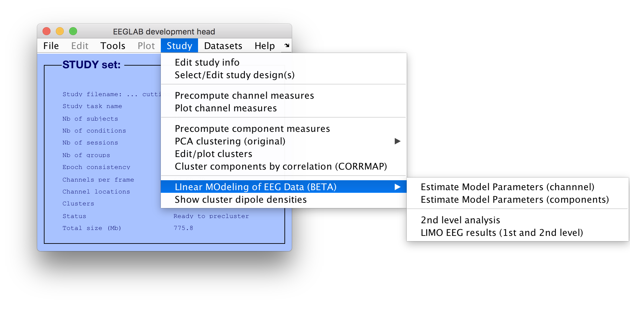
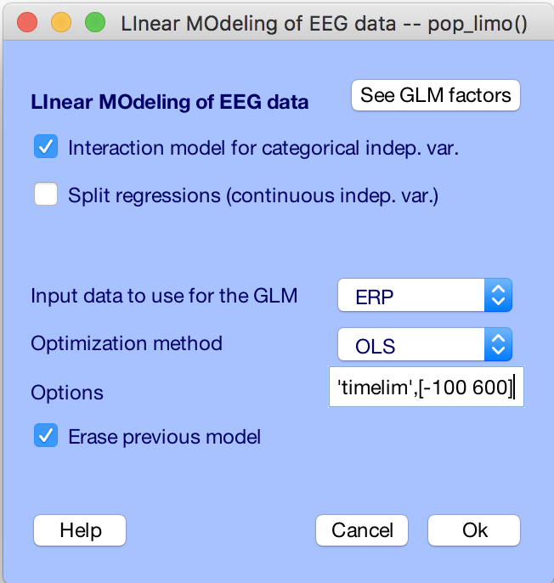
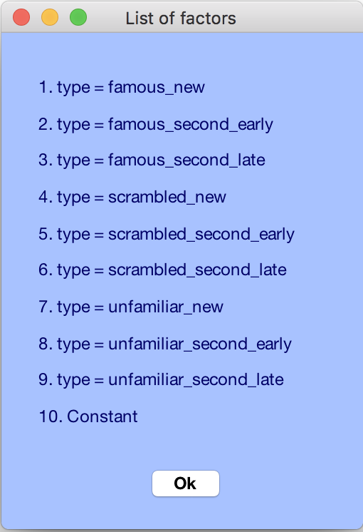
Estimate model parameters
Only the current design is pooled in the GLM
Estimate Model Parameter
Have generated single trials, specified the model, we now do the stats
→ Restrict ‘timelim’, [-50 650]

Slide 18
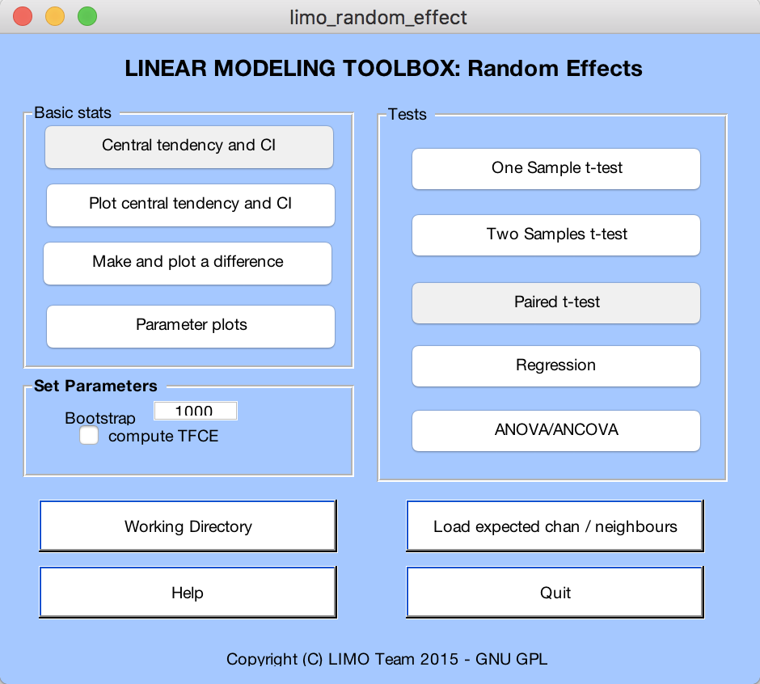
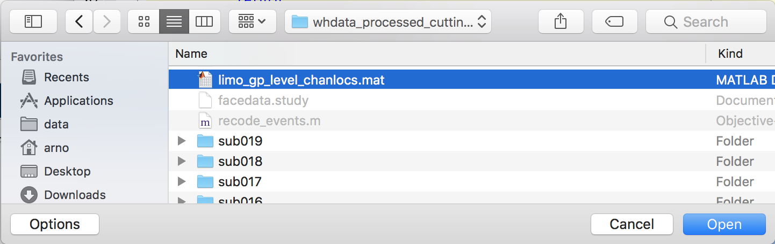
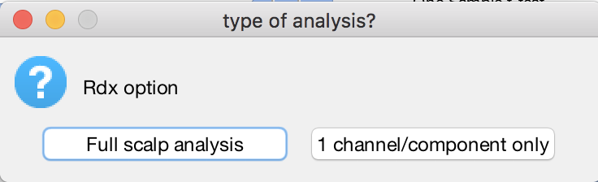
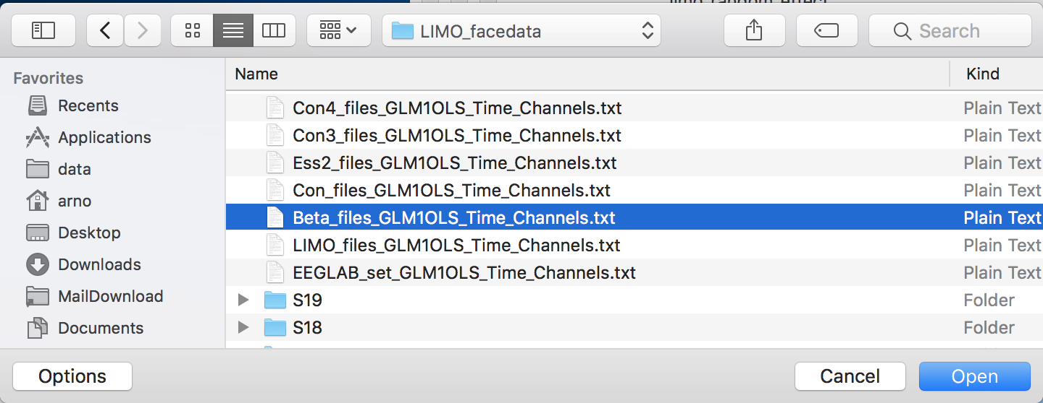
Are Beta significant?

Slide 19
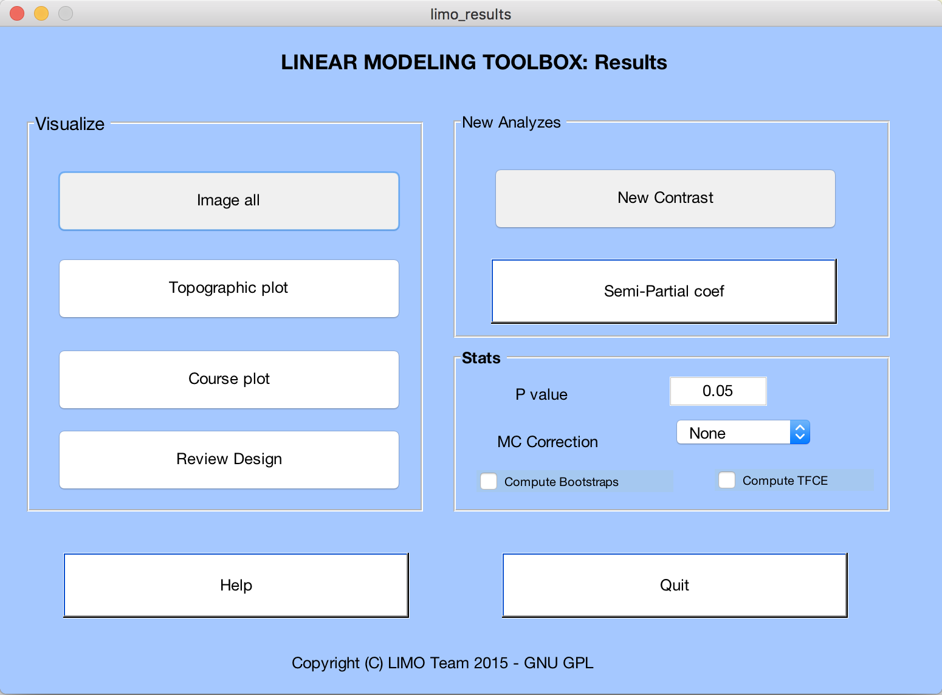
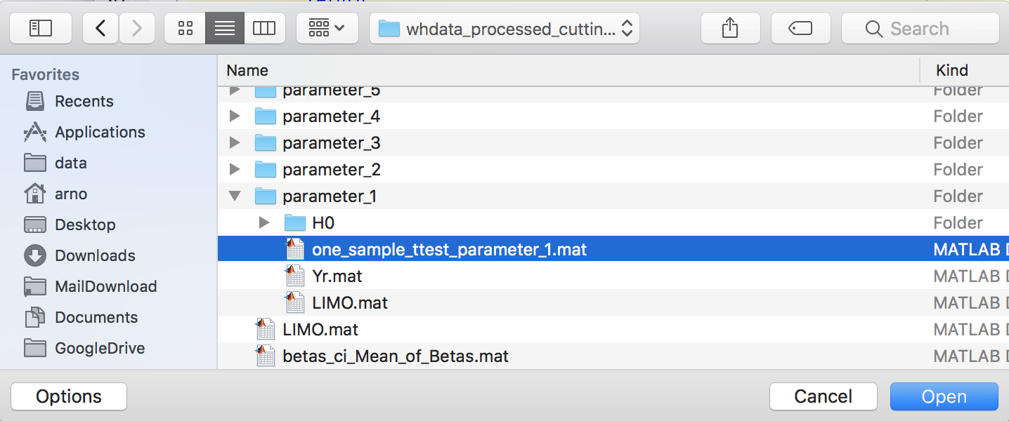

Slide 20
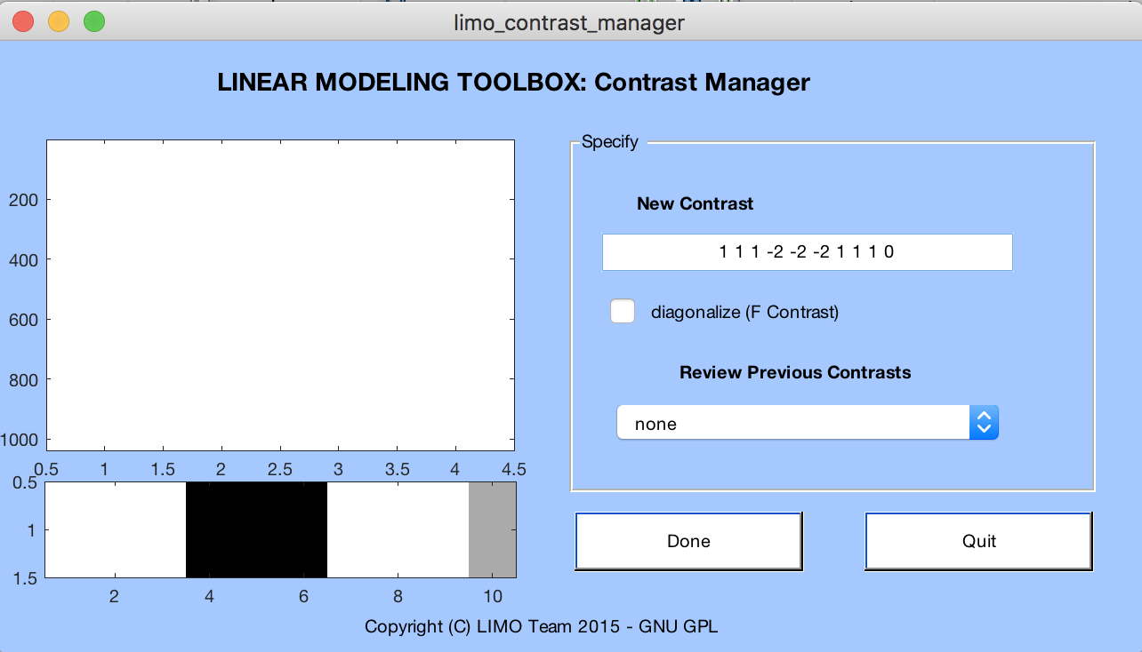
Grouping betas and differences between conditions
Faces vs non-faces
Famous
Scrambled
Unfamiliar
1
1
1
-2
-2
-2
1
1
1
0
1
1
1
0
0
0
0
0
0
0
0
0
0
1
1
1
0
0
0
0
0
0
0
0
0
0
1
1
1
0
1 0 0
1 0 0
1 0 0
0 1 0
0 1 0
0 1 0
0 0 1
0 0 1
0 0 1
0 0 0
1 0 0
0 1 0
0 0 1
1 0 0
0 1 0
0 0 1
1 0 0
0 1 0
0 0 1
0 0 0
Note: array are transposed for readability
ANOVA (famous/scambled/unfamiliar)
ANOVA (new/early/late)

Slide 21
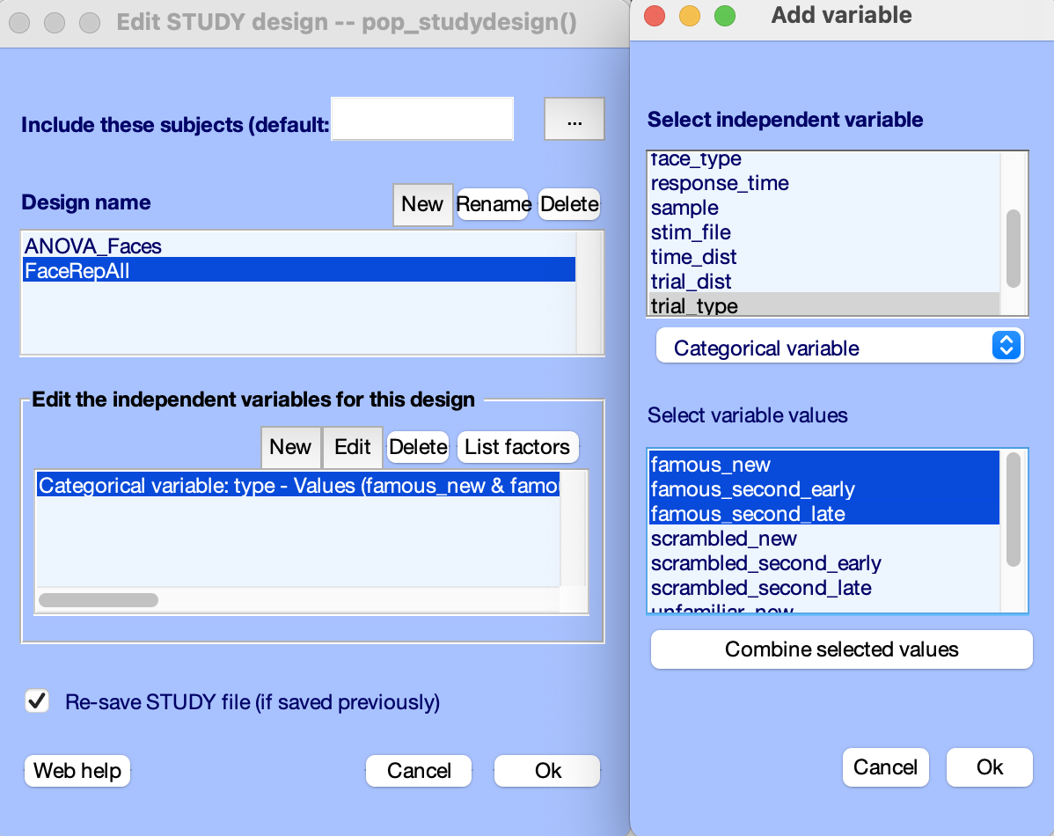
Grouping betas and differences between conditions
Contrast were automatically created when we combined variables
Faces vs non-faces
Famous
Scrambled
Unfamiliar
1
1
1
-2
-2
-2
1
1
1
0
1
1
1
0
0
0
0
0
0
0
0
0
0
1
1
1
0
0
0
0
0
0
0
0
0
0
1
1
1
0
1 0 0
1 0 0
1 0 0
0 1 0
0 1 0
0 1 0
0 0 1
0 0 1
0 0 1
0 0 0
1 0 0
0 1 0
0 0 1
1 0 0
0 1 0
0 0 1
1 0 0
0 1 0
0 0 1
0 0 0
Note: array are transposed for readability
ANOVA (famous/scambled/unfamiliar)
ANOVA (new/early/late)

Slide 22
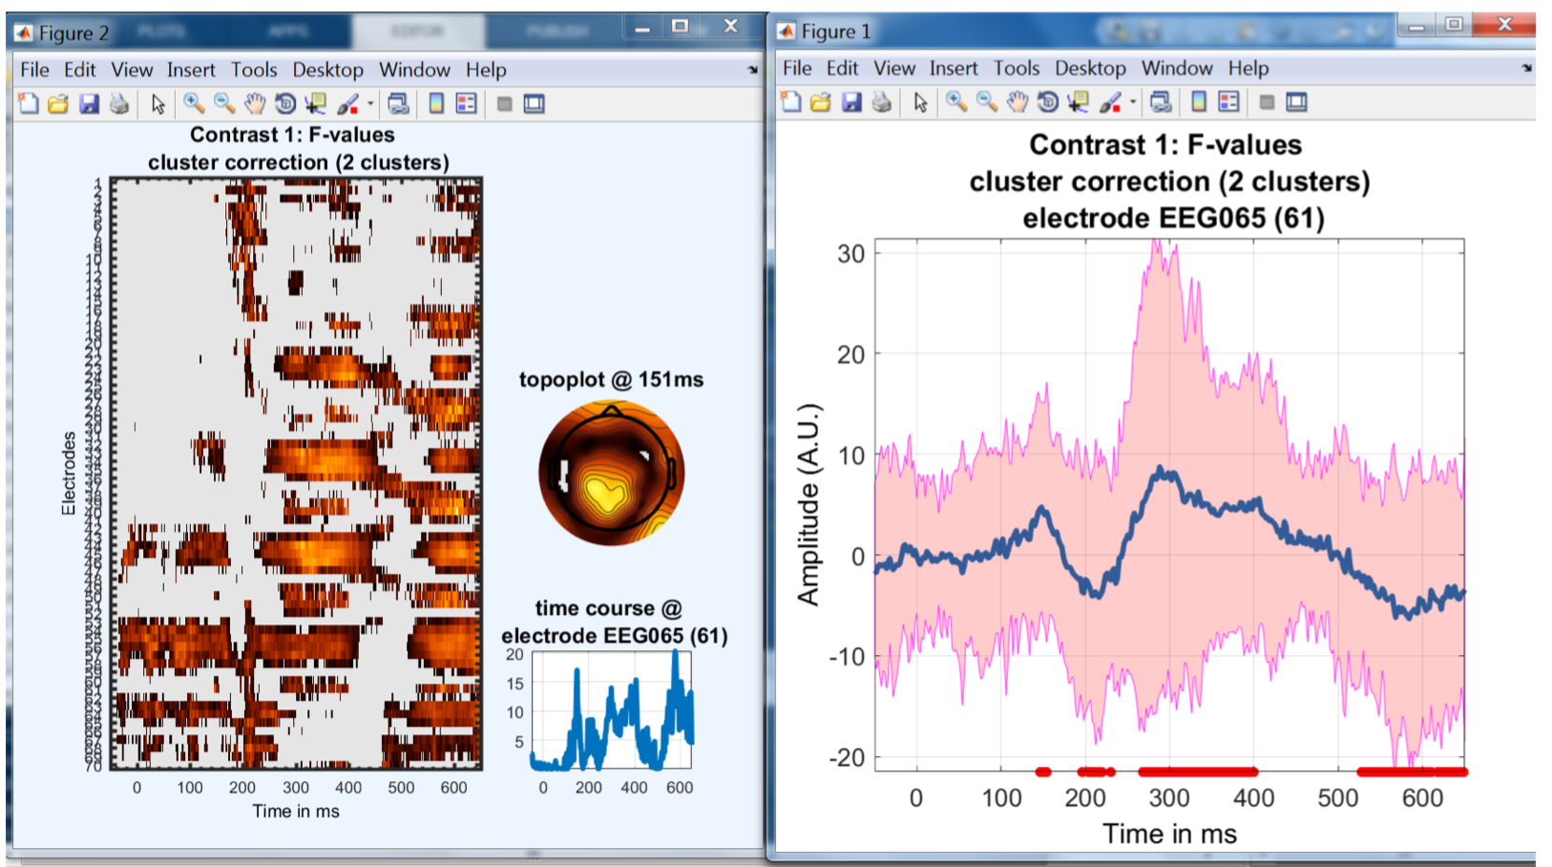
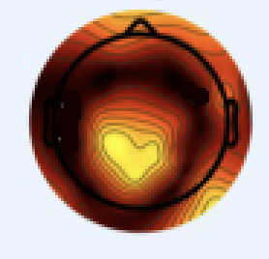
ANOVA (famous/scambled/unfamiliar)

Slide 23
Exercise
Install LIMO plugin
Reload “ds002718processed/Face_detection.study” file
NOT NEEDED HERE -- Edit STUDY and create design (menu item STUDY > Select/Edit STUDY design(s))
NOT NEEDED HERE -- Recompute ERP (remove labeled ICA comp.) (menu item STUDY > Precompute channel measures)
Compute LIMO for all subjects (Menu STUDY > Linear Modeling of EEG data > Estimate Model Parameters (channel))
Compute and plot group level measures (Menu STUDY > Linear Modeling of EEG data > 2nd Level analysis)

